Slide 1

Projekt Marge
Wolny framework do tworzenia aplikacji Bluetooth w języku Java
Sergiusz Urbaniak
Notes:
bluetooth overview (tecnologia e o que serve)
inquiry
service discovery
connection
communication
jsr-82
o que é (gcf)
problema
marge
overview do projeto
core (framework) - o que é
abstração dos passos
video das aplicacões demo
o que está por vir (objetivo de simplicidade)
links/email/blog
campeonato
p&r

Slide 2
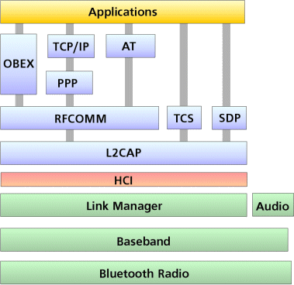
Bluetooth – Architektura

Slide 3

JSR-82 – Wady
Dopasowany do Java ME (GCF)
trudny w pierwszym użyciu
Duplikacja kodu
Nie zawsze jasna implementacja

Slide 4


Marge – Projekt
Łatwiejsze programowanie Bluetooth w Java
  Framework
  Przykładowe aplikacje
Portal na java.net
  http://marge.dev.java.net
  Mobile & Embedded Community
  Listy emails, Wiki, Forum, Subversion, Issue Tracker
LGPL
Mało aktywny od połowy 2008

Slide 5
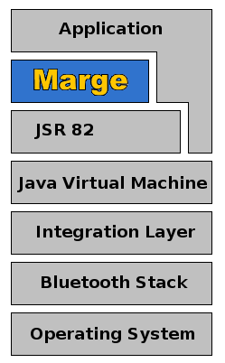
Marge – Framework
marge-core
Abstrackja pakietu javax.bluetooth
Java ME e SE
Aktualna wersja 0.5
33,9 KB (non obfuscated)

Slide 6
Marge – Estrutura
24 klasy
5 pakietów
  net.java.dev.marge.autocon
  net.java.dev.marge.communication
    net.java.dev.marge.communication.layer
  net.java.dev.marge.entity
    net.java.dev.marge.entity.config
  net.java.dev.marge.factory
  net.java.dev.marge.inquiry
Notes:
Essa divisão de pacotes possibilita usar separadamente recursos de busca, comunicação, etc

Slide 7
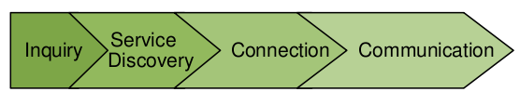
Bluetooth – Kroki w komunikacji

Slide 8
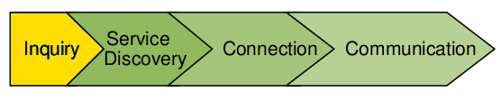
Marge – Szukanie urządzen
LocalDevice localDevice =
LocalDevice.getLocalDevice();
DiscoveryAgent agent =
localDevice.getDiscoveryAgent();
agent.startInquiry(DiscoveryAgent
.GIAC,
new DiscoveryListenerImpl());
DeviceDiscoverer.getInstance().
startInquiryGIAC(
new InquiryListenerImpl());

Slide 9
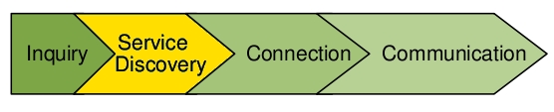
Marge – Szukanie serwisów
LocalDevice localDevice =
LocalDevice.getLocalDevice();
DiscoveryAgent agent =
localDevice.getDiscoveryAgent();
int transactionID = agent.
searchServices(
attrSet, uuidArray, rmtDevice,
new DiscoveryListenerImpl());
ServiceDiscoverer.getInstance()
.startSearch(remoteDevice,
new ServiceSearchListenerImpl());

Slide 10
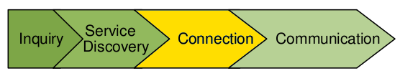
Marge – Serwer (oczekiwanie na klienta)
StreamConnectionNotifier notifier =
(StreamConnectionNotifier)
Connector.open(
"btspp://localhost:” +
”10203040607040A1B1C1DE100;” +
”name=Server1;” +
”authenticate=false;authorize=false");
StreamConnection connection =
notifier.acceptAndOpen();
CommunicationFactory factory =
new RFCOMMCommunicationFactory();
ServerConfiguration sconf =
new ServerConfiguration(
new CommunicationListenerImpl());
factory.waitClients(sconf,
new ConnectionListenerImpl());

Slide 11
Marge – Klient (połaczenie z serwerem)
CommunicationFactory factory =
new L2CAPCommunicationFactory();
ClientConfiguration cconfig =
new
ClientConfiguration(serviceRecordFound, new CommunicationListenerImpl());
ClientDevice clientDevice =
factory.connectToServer(cconf);
String url =
serviceRecord.getConnectionURL( ServiceRecord
.NOAUTHENTICATE_NOENCRYPT,
true);
StreamConnection connection =
(StreamConnection)
Connector.open(url);

Slide 12
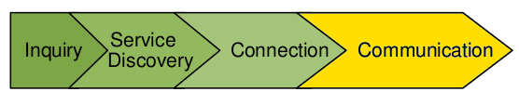
Marge – Wysyłanie danych
DataOutputStream dataout =
connection
.openDataOutputStream();
dataout.writeUTF(”Hello world”);
dataout.flush();
connection.close();
device.startListening();
device.send("Hello world".getBytes());
device.close();

Slide 13

Marge – AutoConnect
AutoConnect.createServer("MargeBluechatServer",
new CommunicationListenerImpl(), new ConnectionListenerImpl());
Serwer
ClientDevice device = AutoConnect.createClient("MargeBluechatServer",
new CommunicationListenerImpl());
Klient

Slide 14
Przykład
Kod komórki
  http://code.google.com/p/studia/source/browse/rok1/mobilne/trunk
Kod serwera
  http://code.google.com/p/studia/source/browse/rok1/mobilneServer
Marge your App!

